Slide 1
COMPILER CONSTRUCTION CS F363
Intermediate Code Generation
Dr. R. Elakkiya, AP/CS

Slide 2
Text Book
Aho, Lam, Sethi and Ullman, “Compilers-Principles, Techniques & Tools”, Pearson/Addison-Wesley, Second Edition, 2013.

Slide 3
Text Book Reading:
Chapter 6
Section 6.1 to 6.9

Slide 4
Overview
Intermediate Code Generation
Forms of ICG
Abstract Syntax Tree (Directed Acylic Graphs)
Three Address Code (3AC/TAC)
Translations
Arrays
Flow of Control Statements
Boolean Expressions

Slide 5
Overview
Intermediate Code Generation
Forms of ICG
Abstract Syntax Tree (Directed Acylic Graphs)
Three Address Code Generation
Translations
Arrays
Flow of Control Statements
Boolean Expressions

Slide 6
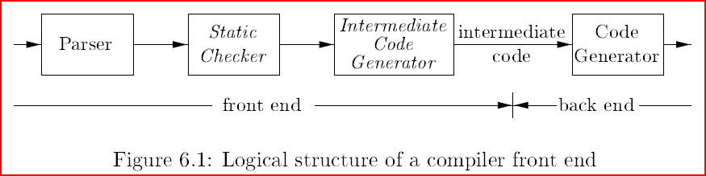
Intermediate Code Generation
Intermediate code is the interface between front end and back end in a compiler
The given program in a source language is converted to an equivalent program in an intermediate language by the intermediate code generator
Ideally the details of source language are confined to the front end and the details of target machines to the back end

Slide 7
Static checking
Type checking: which ensures that operators are applied to compatible operands
syntactic check: assures that a break-statement in C is enclosed within a while-, for-, or switch-statement

Slide 8
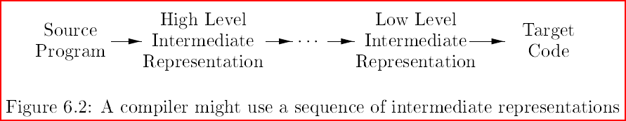
Why Intermediate code?
m computer lang (c, python etc, ), n machines arch (x86, MIPS, ARM). How many compilers to be built?
m * n Enormous efforts.
Solu: Use IC
Convert all lang to IC (Front End)
Convert IC to Machine code (Back End)
m + n
Allows for code optimizations to be performed on IC

Slide 9
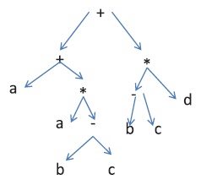
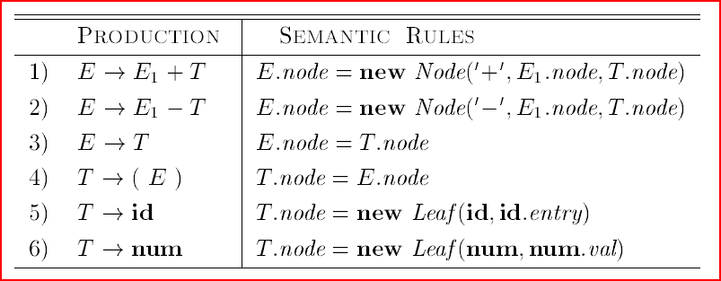
Forms of ICG: 1. Syntax Tree
Nodes in a syntax tree represent constructs in the source program.
The children of a node represent the meaningful components of a construct.
Example: Syntax tree for expression a+a*(b-c) +(b-c)*d

Slide 10
Variants of Syntax Trees
A directed acyclic graph (DAG) for an expression identifies the common subexpressions (subexpressions that occur more than once) of the expression.
In a syntax tree, the tree for the common sub-expression would be replicated as many times as the sub-expression appears in the original expression.
Thus DAG not only represents expressions more succinctly, it gives the compiler important clues regarding the generation of efficient code to evaluate the expressions.

Slide 11
Variants of Syntax Trees: Directed Acyclic Graphs
a DAG has leaves corresponding to atomic operands and interior codes corresponding to operators.
a node N in a DAG has more than one parent if N represents a common subexpression.
Example 6.1 : shows the DAG for the expression

Slide 12
DAG
leaf a : 2 parents, why a appears twice in the expr.
sub-expression b-c is represented by one node ‘-’
Node ‘-’ : 2 parents, why :
sub-expression a*(b-c) and (b-c)*d are different

Slide 13
DAG
Figure 6.4: Syntax-directed definition to produce syntax trees or DAG's
What are the modifications required for constructing DAGs ?

Slide 14
DAG for Expressions
Figure 6.5: Steps for constructing the DAG
Node(….) , Leaf(…)
Check whether an identical node already exists
If yes the existing node is returned
If no create a new node and return it
p1= Leaf (id, entry-a)
p2 = Leaf (id, entry-a) = p1
p3 = Leaf (id, entry- b)
p4 = Leaf(id, entry-c)
P5 = Node('-', p3, p4)
p6 = Node('*', p1, p5)
p7 = Node( '+' p1, p6 )
p8 = Leaf (id, entry-b) = p3
p9 = Leaf (id, entry-c) = p4
p10 = Node('-', p3, p4) = p5
p11= Leaf (id, entry-d)
p12 = Node('*', p5 ,p11)
p13 = Node('+',p7,p12)

Slide 15
Value Number Method for DAG’s
Algorithm 6.3: The value-number method for constructing the nodes of a DAG.
INPUT: Label op, node l, and node r.
OUTPUT: The value number of a node in the array with signature (op, l, r).
METHOD:
Search the array for a node M with label op, left child l , and right child r.
If there is such a node, return the value number of M.
If not, create in the array a new node N with label op, left child l, and right child r, and return its value number.

Slide 16
Value Number Method for DAG’s
The nodes of a syntax tree or DAG are stored in an array of records.
We refer to nodes by giving the integer index of the record for that node within the array.
This integer historically has been called the value number for the node or for the expression represented by the node.
Figure 6.6: Nodes of a DAG for i = i + 10 allocated in an array

Slide 17
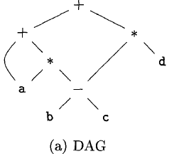
Forms of ICG: 2. Three Address Code
In three-address code, there is at most one operator on the right side of an instruction.
x+y*z
Example 6.4 : Three-address code is a linearized representation of a syntax tree or a DAG in which explicit names correspond to the interior nodes of the graph.

Slide 18
Addresses and Instructions
Three-address code is built from two concepts: addresses and instructions.
Addresses:
A name
A constant
A compiler-generated temporary

Slide 19
Addresses and Instructions
1. Assignment instructions of the form x = y op z
2. Assignments of the form x = op y, where op is a unary operation
3. Copy instructions of the form x = y, where x is assigned the value of y
4. An unconditional jump goto L. The three-address instruction with label L is the next to be executed.
5. Conditional jumps of the form if x goto L and if False x goto L.
6. Conditional jumps such as if x relop y goto L.
7. Procedure calls and returns are implemented using the following instructions: param x for parameters; call p , n and y = call p,n and return y.
8. Indexed copy instructions of the form x = y [i] and x [i] = y.
9. Address and pointer assignments of the form x = & y, x = *y, and *x = y.

Slide 20
Addresses and Instructions
Example 6.5 : Consider the statement
double a[10];
do i = i+l; while (a[i] < v) ;
L:
t1 = i + 1
i = t1
t2 = i * 8
t3 = a[t2]
if t3 < v goto L
a[0]=1000
1001
1002
1003
1004
1005
1006
1007
(a) Symbolic labels
i = i + 1
100:t1 = i + 1
101:i = t1
102:t2 = i * 8
103:t3 = a[t2]
104:if t3 < v goto 100
a[1]=1008
1009
1010
1011
1012
1013
1014
1015
true
a[i] < v
false
(b) Position numbers

Slide 21
Types of Three Address Codes
Quadruples
Triples
Indirect Triples

Slide 22
Quadruples
A quadruple has four fields, which we call
op, arg1, arg2, result.
The op field contains an internal code for the operator.
For instance the three-address instruction
x=y+z is represented by placing
+ in op, y in arg1, z in arg2, and x in result
Some exceptions
Instructions with unary operators like x = minus y or x = y do not use arg2. for a copy statement like x = y, op is =.
Operators like param use neither arg2 nor result.
Conditional and unconditional jumps put the target label in result.

Slide 23
Quadruples
A quadruple has four fields, which we call
op, arg1, arg2, result.
The op field contains an internal code for the operator.
For instance the three-address instruction
x=y+z is represented by placing
+ in op, y in arg1, z in arg2, and x in result
3AC | Quadruple op arg1 arg2 result
x = y op z | op y z x
x = y + z | + y z x

Slide 24
Quadruples
3AC | Quadruple
 |  | op | arg1 | arg2 | result
x = y op z |  | op | y | z
x = op y |  | op | y | - | x
goto L |  | goto | - | - | L
if x goto L |  | if | x | - | L
if false x goto L |  | iff | x | - | L
if x < y goto L | 0: 1: | < if | x t1 | y - | t1 L
x := y[i] | 0: 1: | + =[] | y t1 | i - | t1 x
x[i] := y | 0: 1: | + []= | x y | i - | t1 t1
x = &y |  | & | y | - | x
x = *y |  | =* | y | - | x
*x = y |  | *= | y | - | x

Slide 25
Quadruples
Example 6.6 : Three-address code and quadraple for the assignment a = b * - c + b * - c
(a) Three-address code
(b) Quadruples

Slide 26
Triples
A triple has only three fields
op, arg1, arg2
Quadruples: Result field is used primarily for temporary names
Triples : Result of an operation x op y by its position,
(rather than by an explicit temporary name)
3AC | Quadruple op arg1 arg2 result | Triples Op arg1 arg2
x = y op z | op y z x | 0: op y z 1: = x (0)

Slide 27
Examples
3AC | Quadruple |  |  |  |  | Triples
 |  | op | arg1 | arg2 | result |  | op | arg1 | arg2
x = y op z |  | op | y | z | x | 0: 1: | op = | y x | z (0)
x = op y |  | op | y | - | x | 0: 1: | op = | y x | - (0)
goto L |  | goto | - | - | L |  | goto | L | -
if x goto L |  | if | x | - | L | 0: 1: | == if | x (0) | 1 L
if false x goto L |  | iff | x | - | L | 0: 1: | == iff | x (0) | 1 L
if x < y goto L | 0: 1: | < if | x t1 | y - | t1 L | 0: 1: 2: | < == If | x (0) (1) | y 1 L

Slide 28
Examples
3AC | Quadruple |  |  |  |  | Triples
 |  | op | arg1 | arg2 | result |  | op | arg1 | arg2
x = y op z |  | op | y | z | x | 0: 1: | op = | y x | z (0)
x = op y |  | op | y | - | x | 0: 1: | op = | y x | - (0)
goto L |  | goto | - | - | L |  | goto | L | -
if x goto L |  | if | x | - | L | 0: 1: | == if | x (0) | 1 L
if false x goto L |  | iff | x | - | L | 0: 1: | == iff | x (0) | 1 L
if x < y goto L | 0: 1: | < if | x t1 | y - | t1 L | 0: 1: 2: | < == If | x (0) (1) | y 1 L

Slide 29
Example
Example 6.7 : The syntax tree, triples and quadruples for a = b * - c + b * - c
(a) Syntax tree
(b) Triples
(c) Quadruples
A benefit of quadruples over triples can be seen in an optimizing compiler, where instructions are often moved around.

Slide 30
Indirect Triples
Indirect triples consist of a listing of pointers to triples, rather than a listing of triples themselves.
With indirect triples, an optimizing compiler can move an instruction by reordering the instruction list, without affecting the triples themselves.
Figure 6.12: Indirect triples representation of three-address code

Slide 31
Translations: Arrays
base_{A} is the address of the first location of the array A
width is the width of each array element
low is the lower bound of i
i is the index
One dimensional Array:
Address= base_{A}+(i-low)*width
Two dimensional Array
Addr = baseA+ ((i1-low1)*n2+i2-low2)*width
Multi dimensional Array
Addr =baseA+ ((i1-low1)*np*nq+...(ik-lowk)*nq]*width

Slide 32
Translations: Arrays
base_{A} is the address of the first location of the array A
width is the width of each array element (based on type. 4 for int; 8 for real or double)
low is the lower bound of i
i is the index
One dimensional Array:
Address= base_{A}+(i-low)*width
Address= base_{A}+ i*width (low = 0)

Slide 33
Array (syn tree, 3AC, quads, triples)
a = b[i] + c[i]
 | op | arg1 | arg2
0 | * | i | w
1 | + | b | (0)
2 | =[] | (1)
3 | * | i | w
4 | + | c | (3)
5 | =[] | (4)
6 | + | (2) | (5)
7 | = | a | (6)
=
a
+
=[]
=[]
b
*
c
*
 | op | arg1 | arg2 | result
0 | * | i | w | t1
1 | + | b | t1 | t2
2 | =[] | t2 | - | t3
3 | * | i | w | t4
4 | + | c | t4 | t5
5 | =[] | t5 | - | t6
6 | + | t3 | t6 | t7
7 | = | t7 | - | a
i
w
i
w
t1 = i * w
t2 = b[t1]
t3 = i * w
t4 = c[t3]
t5 = t2 + t4
a = t5

Slide 34
Array (syn tree, 3AC, quads, triples)
[]=
t1 = b * c
t2 = b * d
t3 = t1 + t2
t4 = i * w
a[t4] = t3
a[i] = b *c + b * d
+
a
*
i
w
*
*
b
b
d
c
 | op | arg1 | arg2 | result
0 | * | b | c | t1
1 | * | b | d | t2
2 | + | t1 | t2 | t3
3 | * | i | w | t4
4 | + | a | t4 | t5
5 | []= | t3 |  | t5
 | op | arg1 | arg2
0 | * | b | c
1 | * | b | d
2 | + | (0) | (1)
3 | * | i | w
4 | + | a | (3)
5 | []= | (4) | (2)

Slide 35
Translations: Arrays
base_{A} is the address of the first location of the array A
width is the width of each array element
low is the lower bound of i
i1 is the row index; i2 is the column index
low₁ is the lower bound of i1
low₂ is the lower bound of i2
n₂ is the number of elements in each row
Two dimensional Array
Addr = baseA+ ((i1-low1)*n2+i2-low2)*width
Addr = baseA+ (i1*n2+i2)*width (if low1& low2 are 0)

Slide 36
Translations: Arrays
Let a denote a 2x3 array of integers, and let c, i, and j all denote integers. The width of an integer is 4.
Three-address code for expression c + a[i][j]
t1 = i * 12
t2 = j * 4
t3 = t1 + t2
t4 = a [ t3 ]
t5 = c + t4
+
Addr = base_{A}+ ((i₁-low₁)*n₂+i₂-low₂)*width
= a + ((i-0)*3+(j-0))*4
= a + i*3*4 + j*4
= a + i*12 + j*4
c
=[]
a
+
*
*
 | op | arg1 | arg2 | result
0 | * | i | 12 | t1
1 | * | j | 4 | t2
2 | + | t1 | t2 | t3
3 | + | a | t3 | t4
4 | =[] | t4 |  | t5
5 | + | c | t5 | t6
i
12
j
4
Address = base +[ i1 * width of 1 row + i2 * width of an element]
i * (3*4) + j * 4

Slide 37
Translations: Arrays
Let a denote a 2x3 array of integers, and let c, i, and j all denote integers. The width of an integer is 4.
Three-address code for expression c + a[i][j]
t1 = i * 12
t2 = j * 4
t3 = t1 + t2
t4 = a [t3]
t5 = c + t4
+
Address = base + [ i1 * width of 1 row + i2 * width of an element]
= base + [i * (3*4) + j * 4]
=[]
c
a
+
*
*
 | op | arg1 | arg2 | result
0 | * | i | 12 | t1
1 | * | j | 4 | t2
2 | + | t1 | t2 | t3
3 | + | a | t3 | t4
4 | =[] | t4 |  | t5
5 | + | c | t5 | t6
i
12
j
4

Slide 38
Flow Control
The translation of statements such as if-else-statements and while-statements is tied to the translation of boolean expressions
Boolean expressions
Alter flow of control
Compute logical values
Boolean expressions are composed of the boolean operators (&&, ||, !) applied to boolean variables or relational expressions
Relational expressions are of the form E1 rel.op E2, where E1 and E2 are arithmetic expressions and rel.op can be <, <=, =, !=, >, or >=
|| and && are left-associative
|| has lowest precedence, than &&, then !.

Slide 39
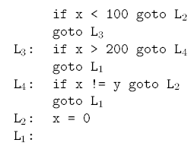
Short-Circuit Code
Jumping code
The operators of the Boolean expression do not appear in the code

Slide 40
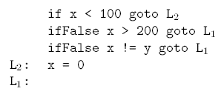
Avoiding Redundant Gotos
if( x < 100 || x > 200 && x != y ) x = 0;
This is short-circuit or jumping code that is generated
 | op | arg1 | arg2
0 | < | x | 100
1 | == | (0) | 1
2 | if | (1) | (9)
3 | > | x | 200
4 | == | (3) | 1
5 | iff | (4) | (10)
6 | != | x | y
7 | == | (6) | 1
8 | iff | (7) | (10)
9 | = | x | 0
10
 | op | arg1 | arg2 | result
0 | < | x | 100 | t1
1 | if | t1 | - | L2
2 | > | x | 200 | t2
3 | iff | t2 | - | L1
4 | != | x | y | t3
5 | iff | t3 | - | L1
6 | label | L2
7 | = | 0 |  | x
8 | label | L1

Slide 41
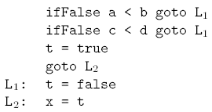
Boolean Values and Jumping Code
x = a<b && c<d
 | op | arg1 | arg2
0 | < | a | b
1 | == | (0) | 1
2 | iff | (1) | (8)
3 | < | c | d
4 | == | (3) | 1
5 | iff | (4) | (8)
6 | = | t | true
7 | goto | (9) | -
8 | = | t | false
9 | = | x | t
 | op | arg1 | arg2 | result
0 | < | a | b | t1
1 | iff | t1 | - | L1
2 | < | c | d | t2
3 | iff | t2 | - | L1
4 | = | true |  | t
5 | goto | - | - | L2
6 | label | L1
7 | = | false |  | t
8 | label | L2
9 | = | t |  | x

Slide 42
Boolean Values and Jumping Code
if (a<b && c<d || d < e) then x = 1; else x = 0
if a < b goto L1
goto L2
L1:if c < d goto L3
goto L2
L2: if d < e goto L3
goto L4
L3: x = 1
goto L5
L4: x = 0
L5:
iffalse a < b goto L2
if c < d goto L3
L2: iffalse d < e goto L4
L3: x = 1
goto L5
L4: x = 0
L5:

Slide 43
Translation scheme - while
while(a<b) {
c = a + b
a = a + 1
}
 | op | arg1 | arg2 | result
0 | LABEL | L1
1 | < | a | b | t1
2 | iff | t1 | - | L2
3 | + | a | b | t2
4 | = | t2 | - | c
5 | + | a | 1 | t3
6 | = | t3 |  | a
7 | goto |  |  | L1
8 | LABEL | L2
L1:
ifFalse a < b L2
t1 = a + b
c = t1
t2 = a + 1
a = t2
goto L1
L2:

Slide 44
Translation scheme - for
sum = 0
for(i=0; i< n; i++) {
sum = sum + i
}
 | op | arg1 | arg2 | Result
0 | = | 0 |  | sum
1 | = | 0 |  | i
2 | LABEL | L1
3 | < | i | n | t1
4 | iff | t1 | - | L2
5 | + | sum | i | t2
6 | = | t2 |  | sum
7 | goto |  |  | L1
8 | LABEL | L2
sum = 0
i = 0
L1:
ifFalse i < n L2
t1 = sum + i
sum = t1
i=i+1
goto L1
L2:

Slide 45
Thank you

